Slide 1
Jena Reasoner API Tutorial: Guardians of The Galaxy 🪐
By: Marshanah Taylor

Slide 2
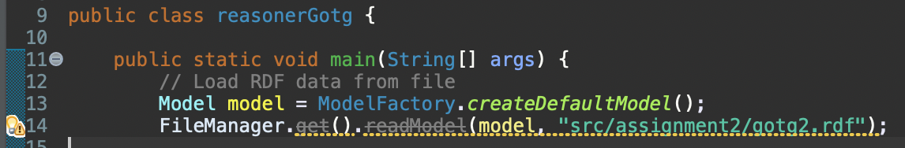
Reading the
“gotg.rdf” File In
Use ‘FileManager’ to read the gotg.rdf file.

Slide 3
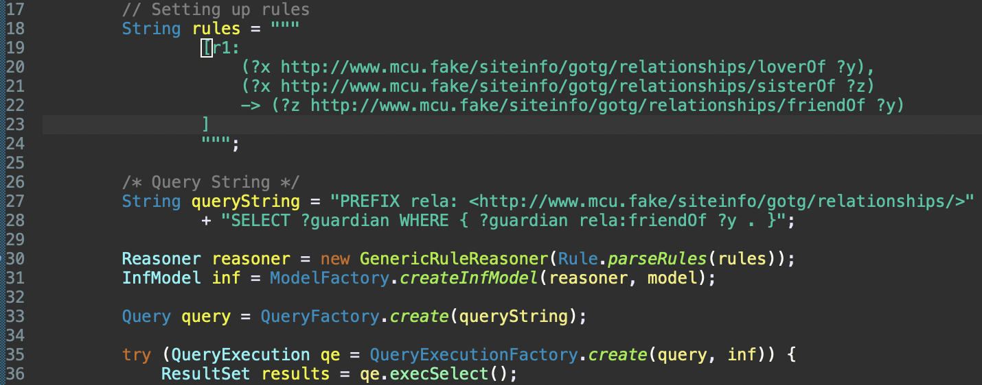
Using RDF Reasoner API & Querying w/ SPARQL
Use the ‘GenericRuleReasoner’ to set the inference relationship between Gamora, Quill, and Nebula. The rules state that Gamora (x) is the lover of Quill (y) and Gamora (x) is the sister of Nebula (z); therefore, it can be inferred that Nebula (z) is a friend of Quill (y). Based on these conditions, the query results should yield that Nebula is the guardian that Quill is friends with.

Slide 4
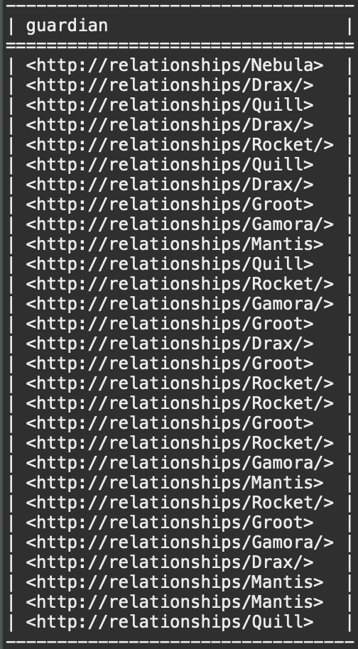
Querying w/ RDF SPARQL API (Results)
As expected, Nebula is the first result at the top of the list as the chosen guardian closest to answering the SPARQL query.

Slide 5
Thank You!

